Slide 1
GET FIT FITNESS TRACKER

Slide 2

TEAM MEMBERS
Ajay Shukla
Manish Kumar Verma
Kashyap Koul
Rahul Premani
Chirag Dhussa
Indrajeet
Vaishnavi

Slide 3

INTRODUCTION
The main objective of this project is that the user can track his fitness by having control over his/her calories.
The user can choose his/her goals according to the type of fitness he/she wants to achieve.
The user will be given recommendations about the diet plans he/she should follow in order to achieve his/her goals.
The user can track his calories and he can evaluate his performance from graphs which shows user his/her expected and actual fitness results.
The user will be given daily motivational quotes that will motivate him to achieve their goals.

Slide 4
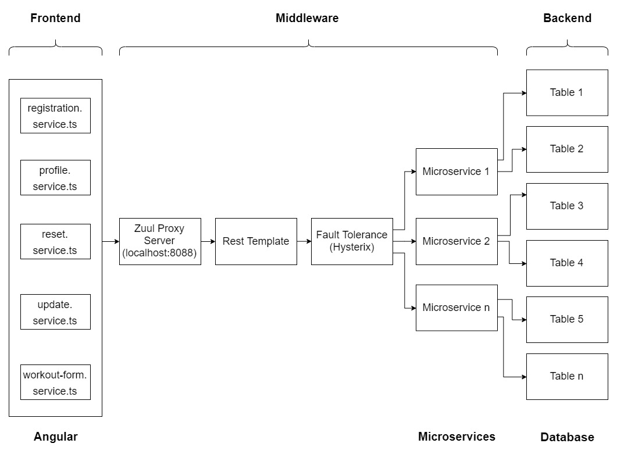
APPLICATION ARCHITECTURE

Slide 5
SCOPE OF THE APPLICATION
This application will help users to stay fit.
This application will help users with daily meals that is recommended to him/her according to their goals.
This application is mobile-friendly as well as desktop-friendly.

Slide 6
TECHNOLOGIES USED
FRONT END:
HTML
CSS
JavaScript
Typescript
Bootstrap 4
JQuery 3.4
Angular 8
MIDDLEWARE:
Spring Boot
Spring JPA
Eureka
Zuul
Hysterix
BACK END:
MySQL Database
TESTING:
JUnit Testing
DOCUMENTATION:
Swagger

Slide 7

FUTURE SCOPE
Integration with Smartwatches
Social Login
Payment Gateway

Slide 8
Demo Time !

